Slide 1
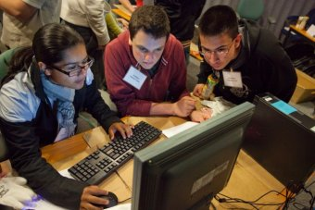
Why Blended Learning?
Independent learning
Digital literacy
Flexibility
Efficiency
Covid19 - Closure and the new normal

Slide 2

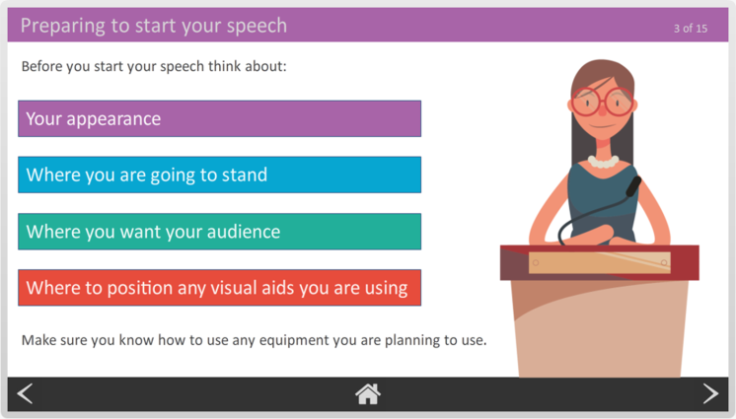
Why a consortium?
Lessons learnt at HOW College, issues with commercial, free and homemade content
High costs of developing quality content
Similar content needs
Benefits of sharing costs
Developing capacity
“For the sector by the sector”

Slide 3
Blended Learning Consortium- FE
How it works
Open democratic partnership led by HoW College with democratic decision making on content developed
Annual membership fee of £5K, free to Specialist Colleges
Members vote on content to be developed
Staff in member colleges paid to write and develop content (Involvement in this is optional)
Sharing existing quality content with other members
Members get all content developed, source files and later updates

Slide 4
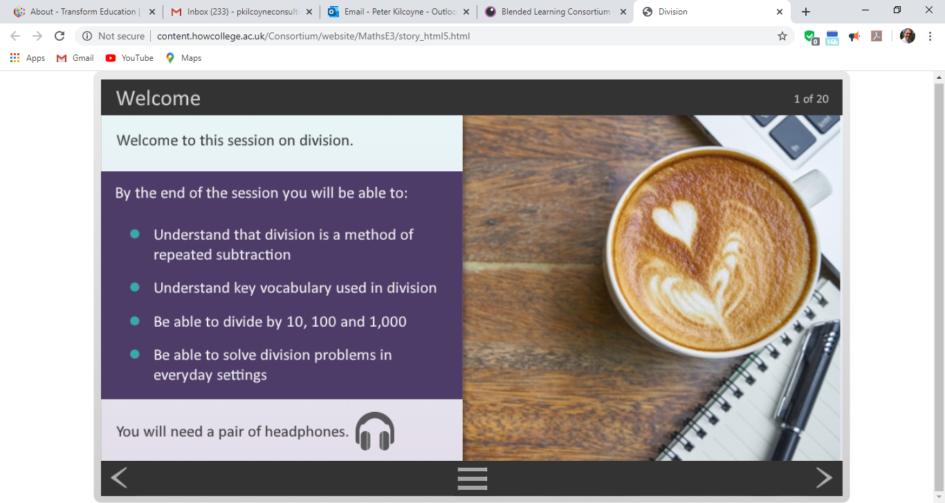
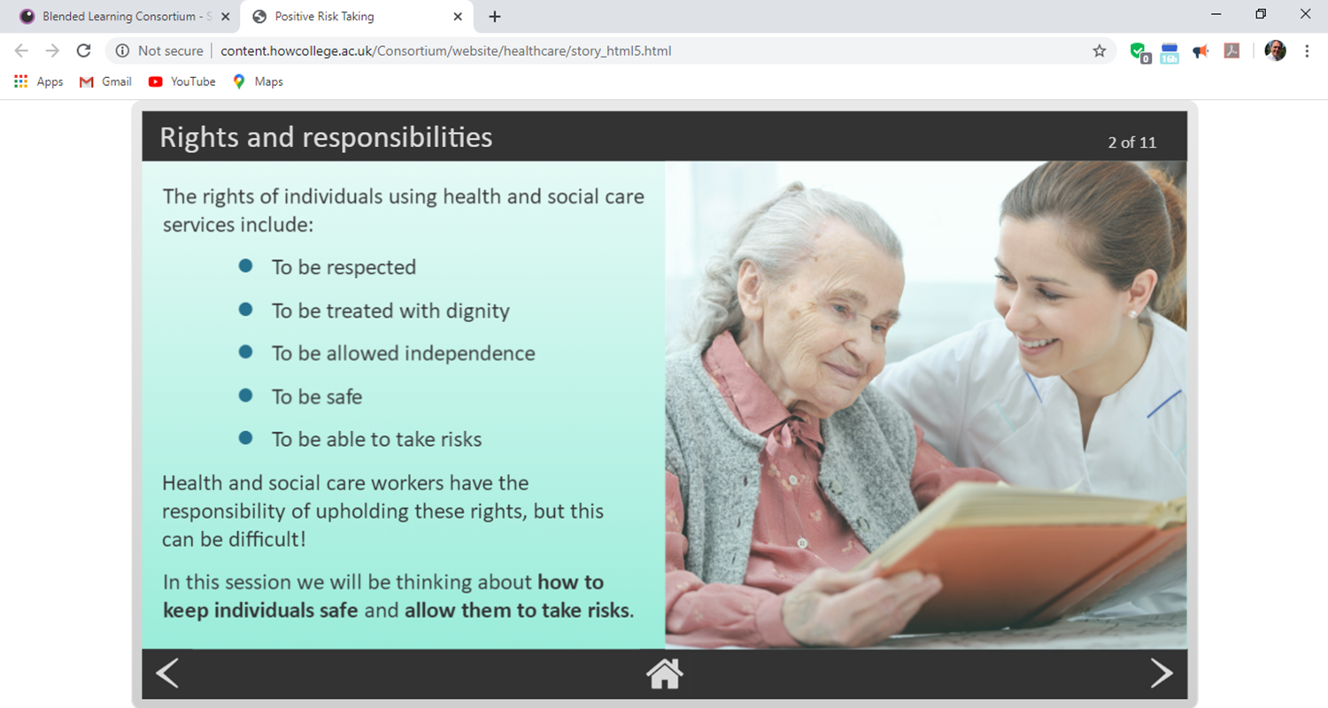
Progress to date
Over 130 learning providers have joined. This is over 50% of all UK Colleges
Over 1800 one hour interactive resources in more than 50 subject areas/levels.
Over 120 5 min videos
Members get all content plus source files – can repurpose and adapt
Accessible versions for all resources
Repository options for Moodle, G-suite and Teams

Slide 5
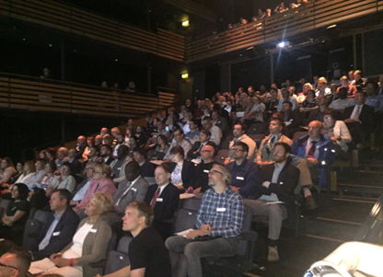
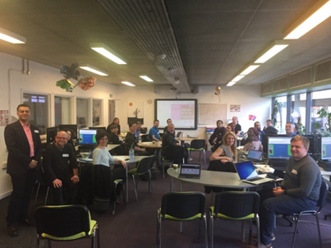
BLC Community
Community as important as content
Monthly webinars
Termly regional meetings
Annual conference
Annual democratic learning impact award
Over 30 exclusive offers with major companies offering digital services to colleges

Slide 6
Any Questions?
For more info -
pkilcoyne@howcollege.ac.uk
http://blc-fe.org/

